Slide 1
Multivariate Timeseries Analysis with missing data

Slide 2
Problem Statement
Research current methodologies on multivariate timeseries analysis with missing data
Suggest deep RL based approach

Slide 3

Objective
Compare various existing methodologies for analyzing multivariate time series data that contain missing values.
Use various datasets for comparison
Deep RL to capture the complex time series pattern and the dependence between variables.

Slide 4
Requirements
Speed
Stability
Experimenting with deep RL for prediction
Not using external libraries

Slide 5

Citations

Slide 6

Benchmark datasets
UCI Machine Learning Repository
MIMIC-III (The Medical Information Mart for Intensive Care dataset)
Numenta Anomaly Benchmark (NAB)
PhysioNet
Yahoo News Feed
EEG Motor Movement/Imagery Dataset
Kaggle

Slide 7
Baseline approach
LSTM Networks
Guassian Processes
Dynamic Bayesian Networks
Hidden Markov Models
Vector Autoregression
Ensemble method
Transfer learning

Slide 8
Metrics for comparision

Slide 9
Prediction Algorithm
Feedforward learning data processing model
Prediction improvement using correlation between multiple timeseries
Establish data volume prediction model
Calculate deviation between actual and predicted data

Slide 10
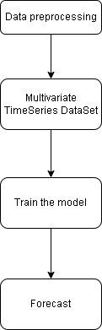
Prediction Algorithm

Slide 11
Suggested approach
Combine the ability of statistics with deep RL
Ensemble method with transfer learning
Estimate a VAR properly on our training data
Extract what VAR has learned
Use for training LSTM model

Slide 12
Why this approach
A model works well with specific characteristics of data –
dimensionality
presence of missing values
nonlinearity
the complexity of the underlying system
Interpretability
Computational requirement

Slide 13
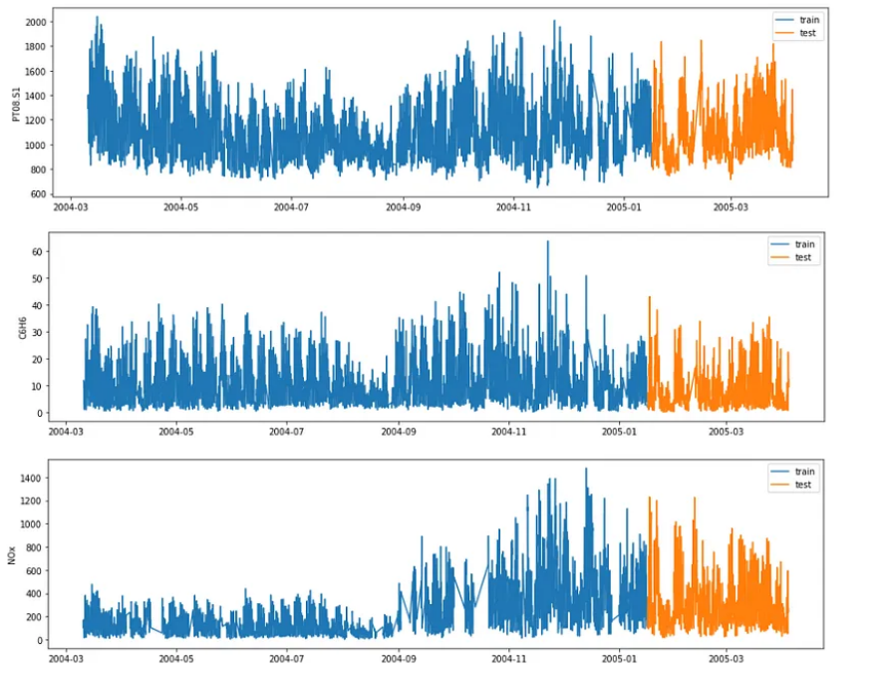
Example of air quality data
Dataset - https://archive.ics.uci.edu/ml/datasets/Air+Quality
Hourly averaged responses from sensors in a city

Slide 14
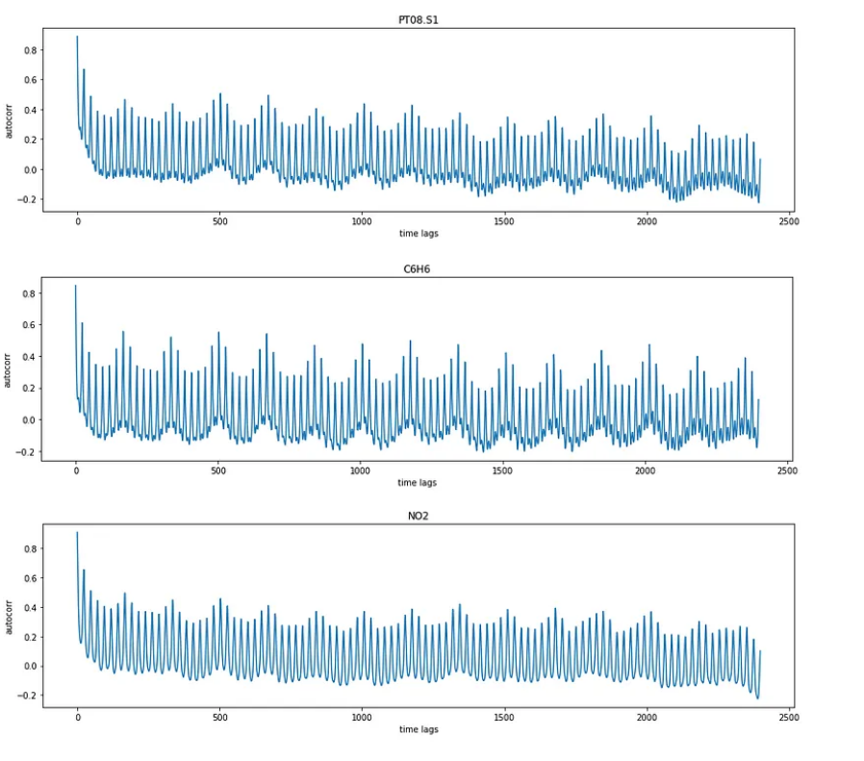
VAR modelling

Slide 15
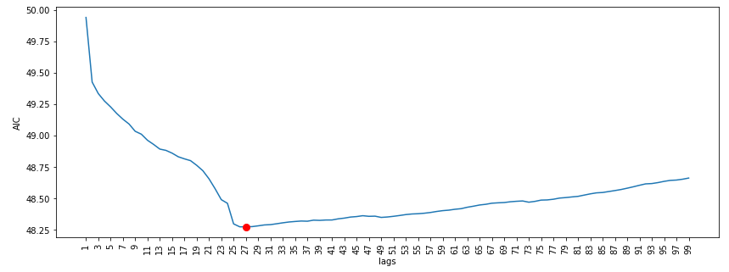
Model Fitting with automatic AIC/BIC

Slide 16
Combine VAR and LSTM
Feeding LSTM autoencoder, using the fitted values produced by VAR, for multi-step ahead forecasts of all the series.
Then we conclude the training with the raw data

Slide 17
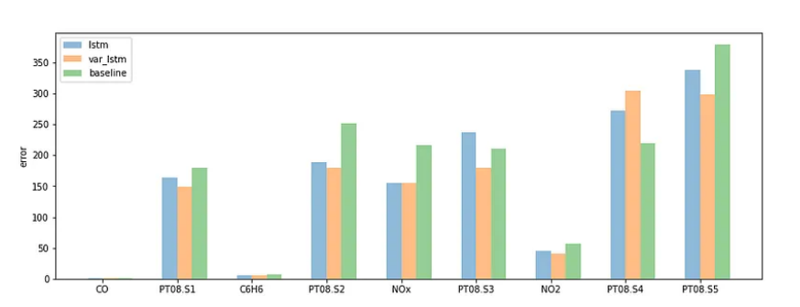
RMSE on test data

Slide 18
VAR without RL
To deal with MTS, one of the most popular methods is Vector Auto Regressive Moving Average models (VARMA) that is a vector form of autoregressive integrated moving average (ARIMA) that can be used to examine the relationships among several variables in multivariate time series analysis.
Yash P Mehra’s 1994 article: “Wage Growth and the Inflation Process: An Empirical Approach” Dataset link - https://raw.githubusercontent.com/selva86/datasets/master/Raotbl6.csv
The dataset has 123 rows and 8 columns.

Slide 19
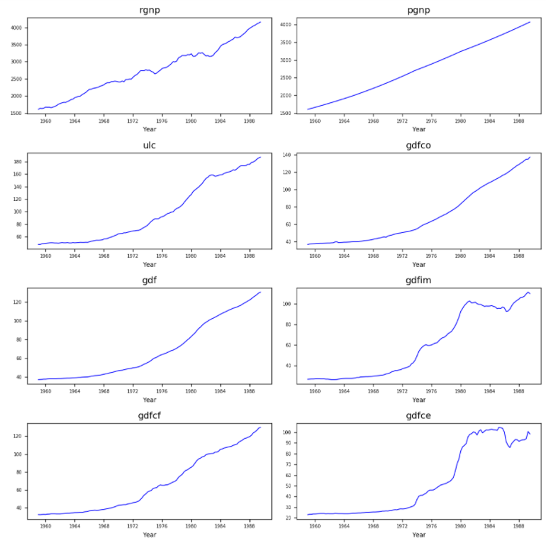
Visualize the data in the figure below and through our observation, all 8 variables has no obvious seasonality and each curve slopes upward.

Slide 20
Model Building
Causality investigation
Test for stationary
Model Building
Test for residuals (errors)

Slide 21
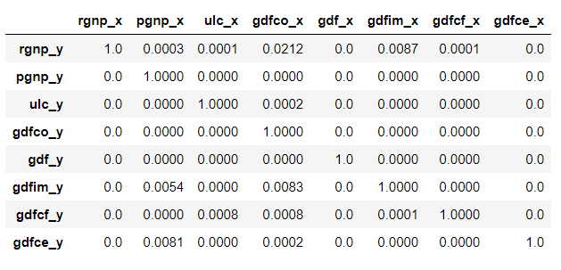
Causality Investigation
Granger causality is a way to investigate the causality between two variables in a time series which actually means if a particular variable comes before another in the time series.
The Null Hypothesis of the Granger Causality Test is that lagged x-values do not explain the variation in y, so the x does not cause y.
The critical value we use is 5% and if the p-value of a pair of variables is smaller than 0.05, we could say with 95% confidence that a predictor x causes a response y.

Slide 22
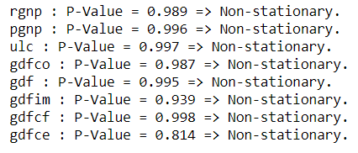
Stationary Test

Slide 23
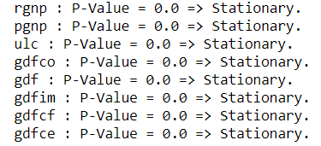
Stationary Test
Multiple differencing method to make them stationary.

Slide 24
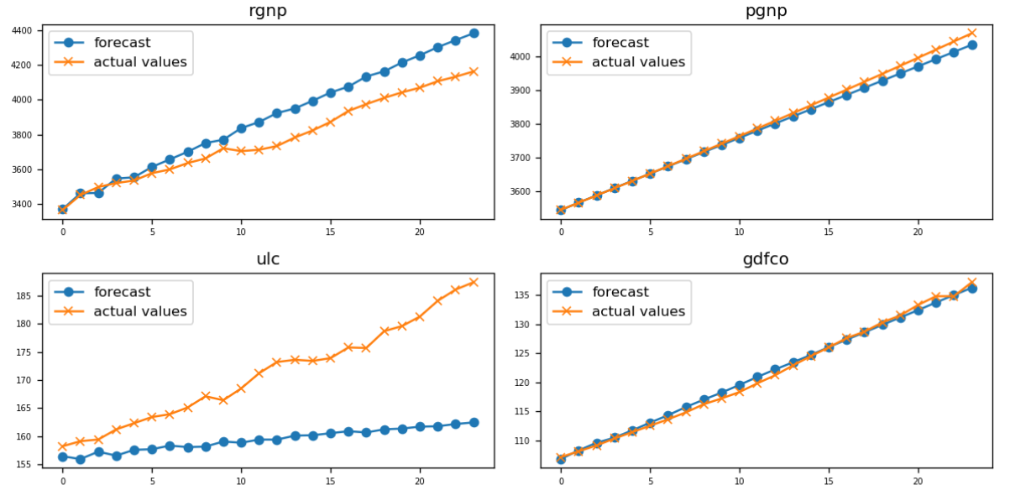
Model Forecasting

